Slide 1
Irrigation Prediction
Adrien Chabert
1

Slide 2





Bachelor Project - UNIGE
2

Slide 3


200’000 km³ of fresh water
3
Notes:
200’000 km3 of fresh water on earth
2/3 for irrigation
Decrease water consumption of 20%-25%
3

Slide 4
Research of Literature
75%
Collect Data
66%
Integration of Machine Learning Algorithm
80%
Test our result 50%
Create a watering plan 0%
4

Slide 5
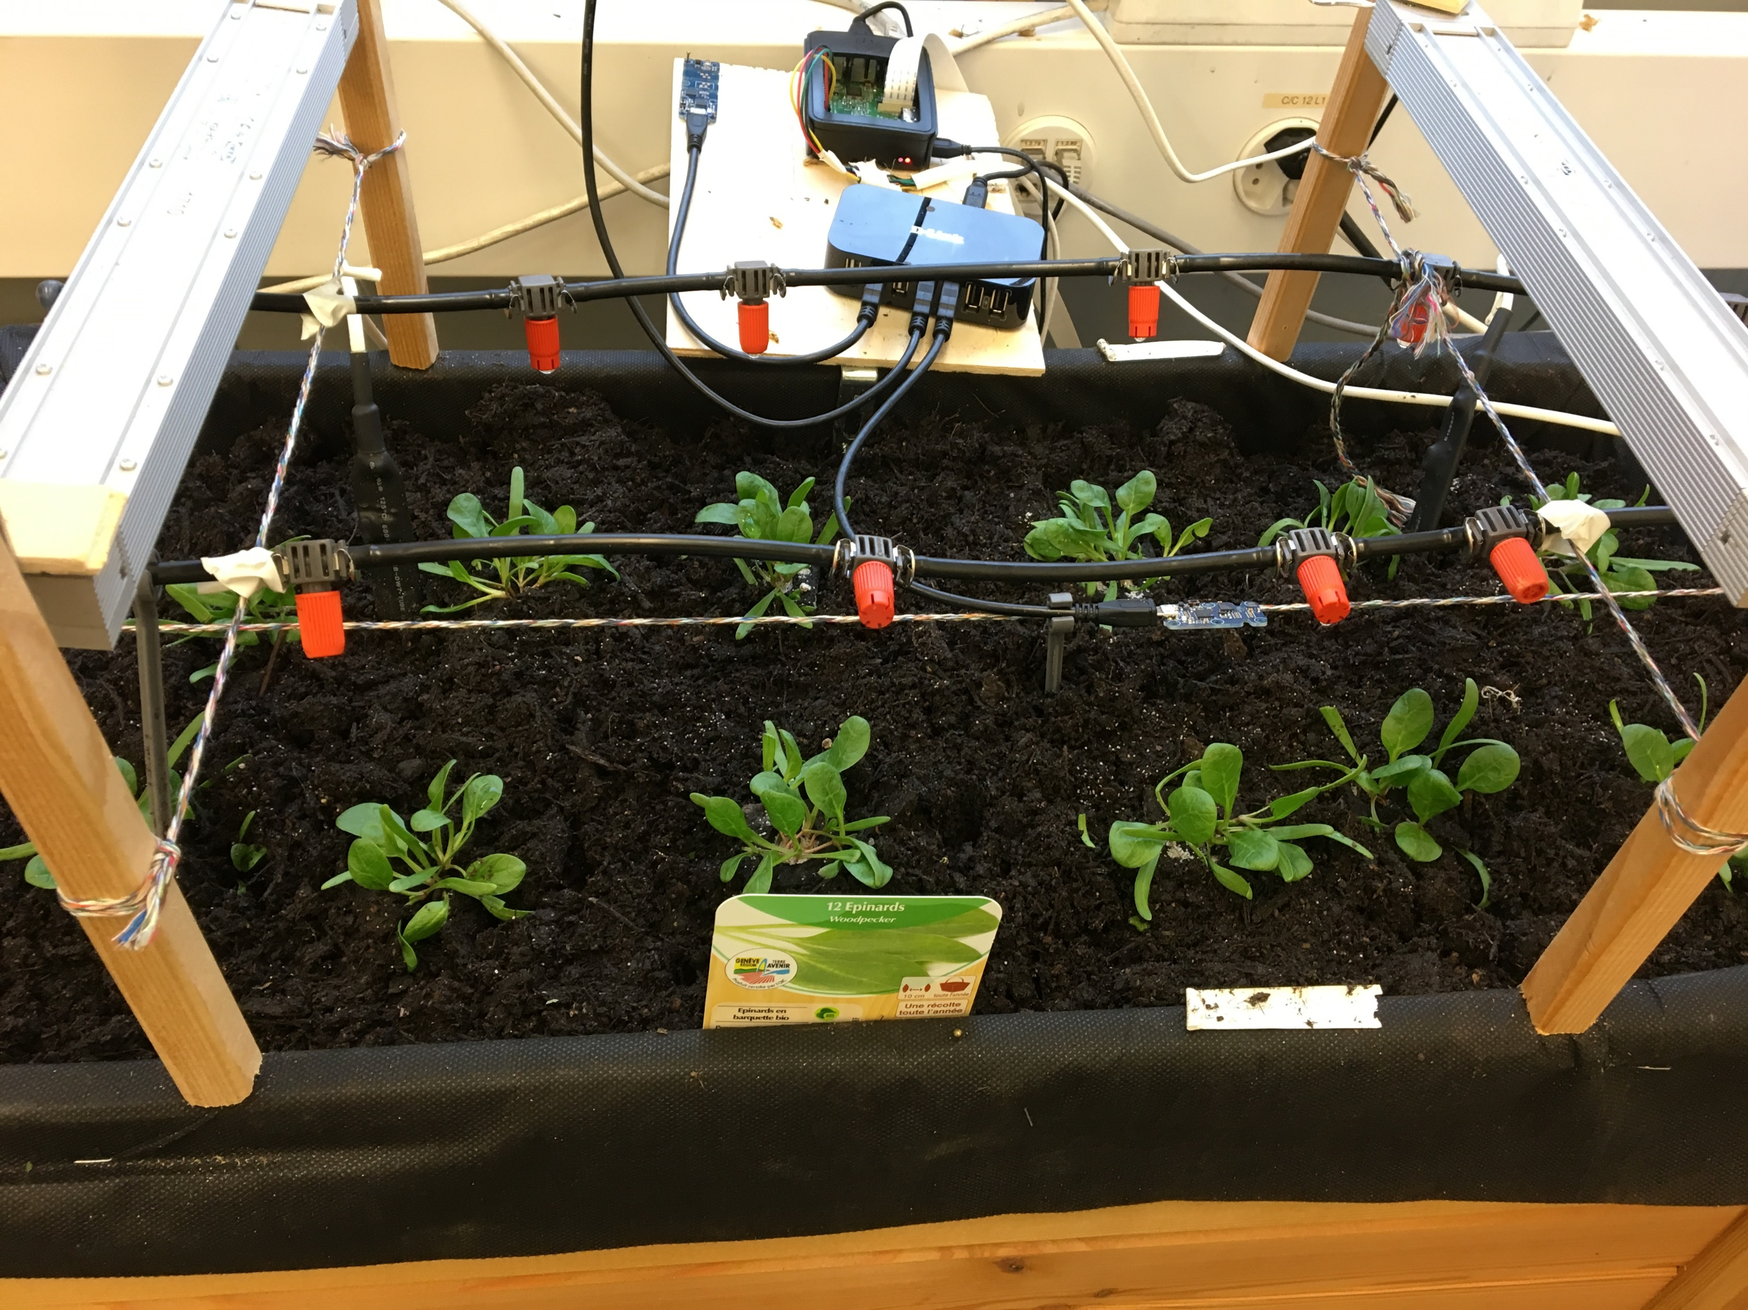
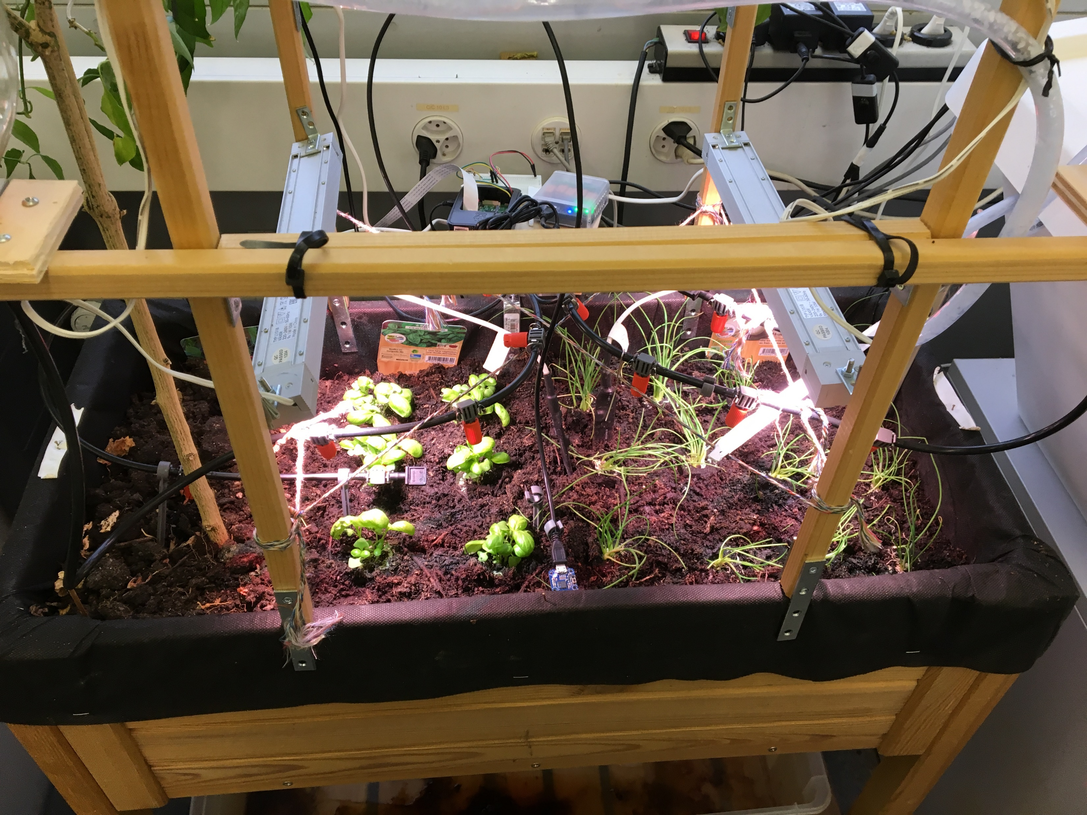
Planting
Basilic, onion, spinach
5

Slide 6
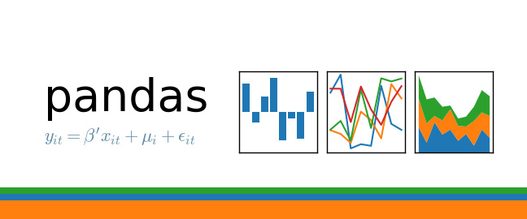



6

Slide 7
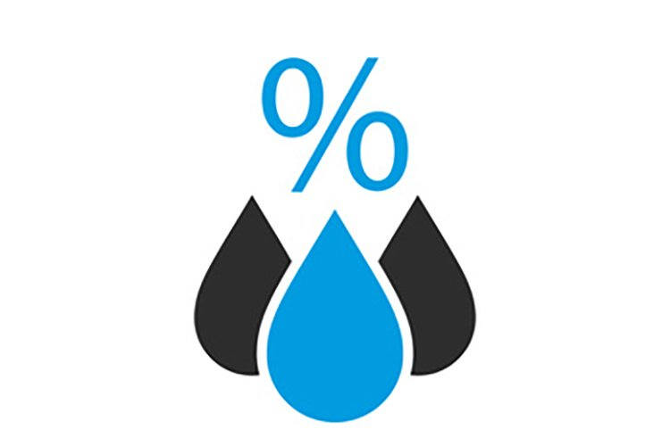
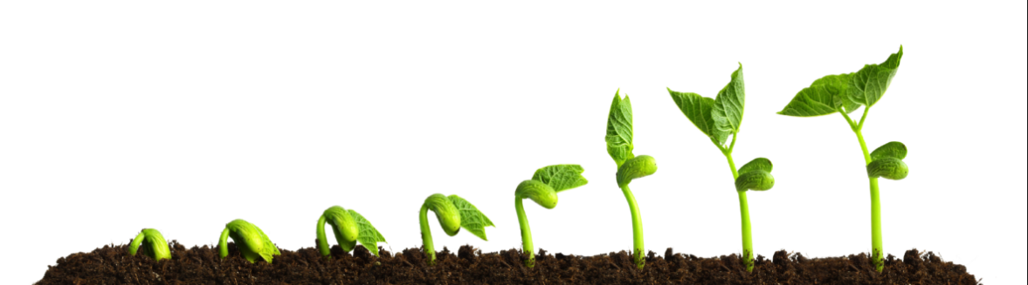


7
Notes:
Le vent impacte également mais pas dans notre cas
7

Slide 8
Problems from last meeting
Position of the humidity sensor
Defective Captor
Pandas and Matplotlib not working on Jupyter
Difficulty to implement ML
Lack of knowledge of ML
8

Slide 9
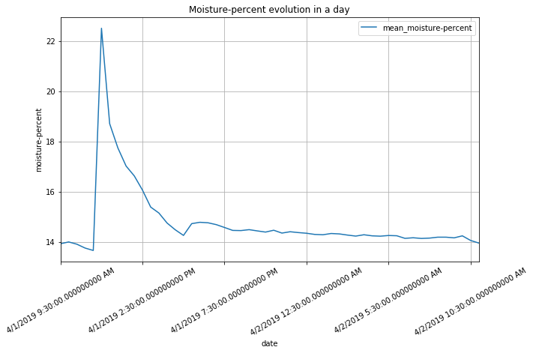
9
Notes:
9

Slide 10
What I did with my data
Reading data in dataframe
Add information on my dataframe
Eliminate NaN value
Implement some different strategy
Analyse result
10
Notes:
J’ai pas ajouté l’information sur la croissance de la plante.

Slide 11
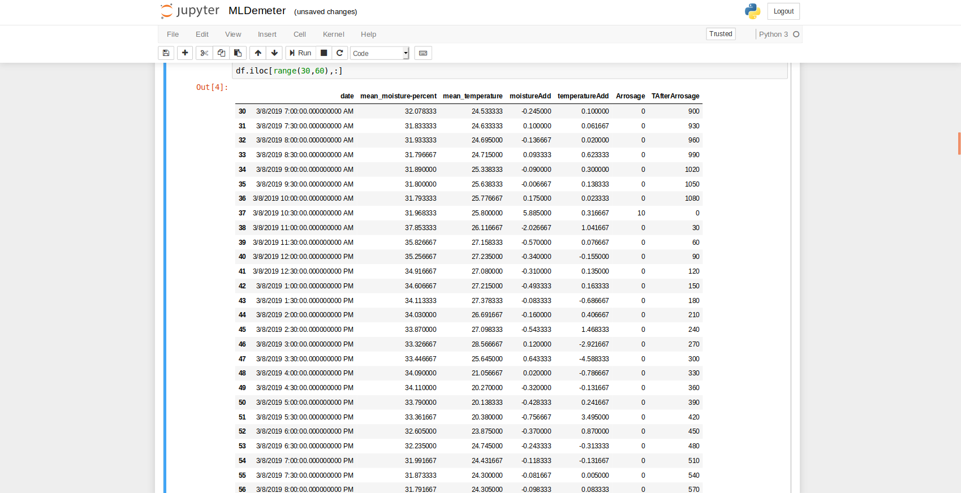
11

Slide 12
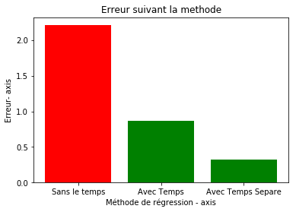
12

Slide 13
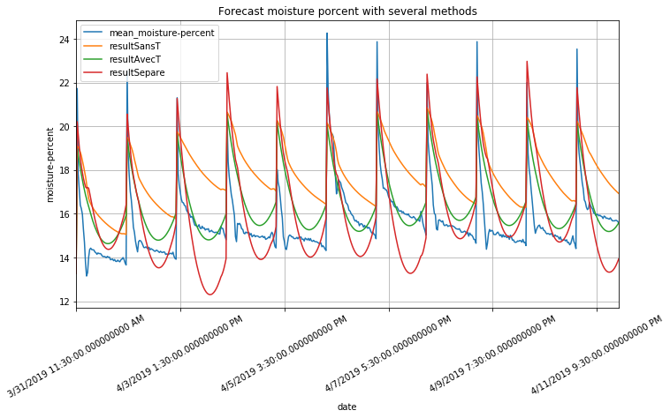

Slide 14
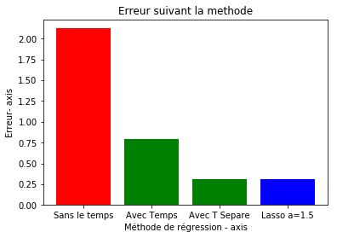
Erreur avec Lasso (a = 1.5) = 0.310217391543

Slide 15
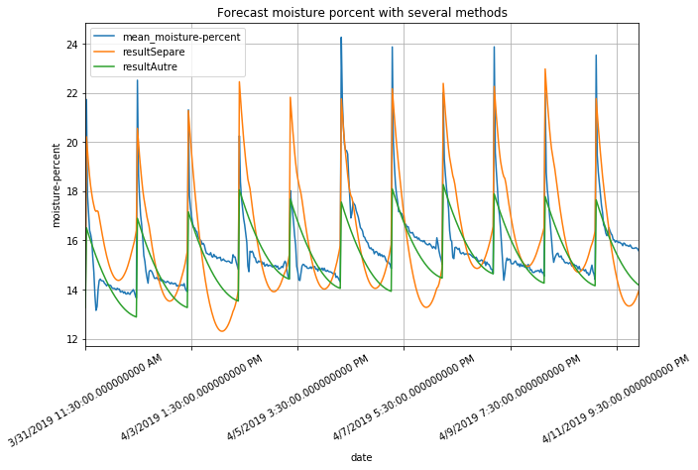

Slide 16
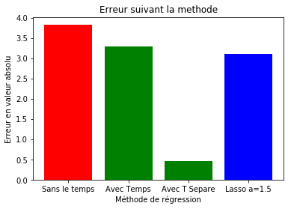
Test on dataset not included in the training data

Slide 17
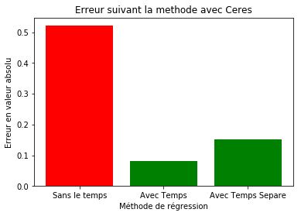
On Demeter

Slide 18
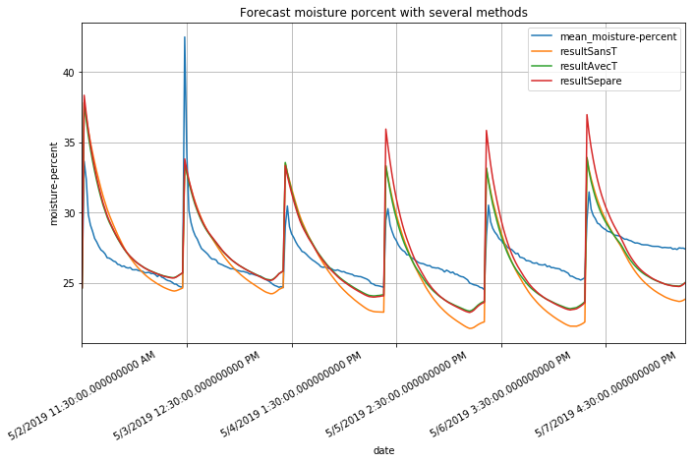

Slide 19
Date | Demeter | Ceres
6-Mar | 10 s/j | 10 s/j
13-Mar | 10 s/j | 10 s/j
20-Mar | 10 s/j | 10 s/j
27-Mar | 20 s/j | 15 s/j
3-Apr | 20 s/j | 15 s/j
10-Apr | 20 s/j | 15 s/j
17-Apr | 40 s/j | 30 s/j
24-Apr | 40 s/j | 30 s/j
1-May | 40 s/j | 30 s/j
3-May | 35s/j | 20 s/j
8-May
15-May
Watering Plan
19
Notes:
19

Slide 20
Planning for the next 3 weeks
To move on with my final written report
To analyse and to chose the best algorithm
To create a watering programme
Depending on temperature forecast
Watering planning covering several days
20
Notes:
Ou Bayesian learning machine approach for Regression
20

Slide 21
Project Planning
21

